Slide 1
HTML forms Part 1

Slide 2
HTML Form Tags
HTML website forms should be enclosed inside the FORM tags. There are various parameter options available, the most common ones are: action - this allows you to tell the form where to go once submitted (usually the filename of a script which will read and process the form data which has been submitted). name - it's usually a good idea to give your forms a name, this is used to uniquely identify your form on a given page. method - the value of this should be POST or GET. This tells the form how to send the data once submitted. Forms should usually always be set to use POST (as GET will attached the form data onto the page URL which is almost always a bad idea for security reasons). There are some other methods available, but we will not discuss these here.
<form action="index.php" name="myform" method="POST">
Example form field: <input type="text" name="example">
</form>
Example form field:

Slide 3
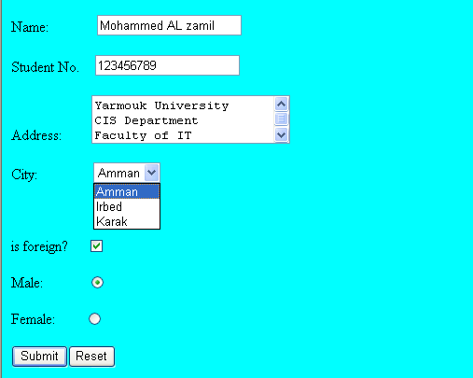
Form elements
<INPUT> Element’s Properties
TYPE= Type of INPUT entry field.
NAME = Variable name passed to CGI application
VALUE= The data associated with the variable name to be passed to the CGI application
CHECKED= Button/box checked
SIZE= Number of visible characters in text field
MAXLENGHT= Maximum number of characters accepted.
Sami Ali
TYPE elements have values:
Text boxes,
Password boxes,
Submit
Reset
Checkboxes,
Radio buttons,
File,
Hidden
Mutah University

Slide 4

1- HTML Text Field - Single Line
Text boxes: Used to provide input fields for text, phone numbers, dates, etc.
<input type= "text " > Browser will display
Textboxes use the following attributes:
type: text.
size: determines the size of the textbox in characters. Default=20 characters.
maxlength : determines the maximum number of characters that the field will accept.
name: is the name of the variable to be sent to the CGI application.
value: will display its contents as the default value
<form action="index.php">
Enter your name: <input type="text" name="your_name“ >
</form>

Slide 5
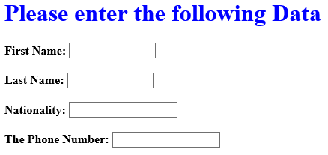
Example of Text Box
<TITLE>Form_Text_Type</TITLE>
<HEAD> <BODY>
<h1> <font color=blue>Please enter the following Data</font></h1>
<form name="form1" Method= " get " Action= " URL " >
First Name: <input type="text" name="FName" size="15" maxlength="25"><BR><BR>
Last Name: <input type="text" name="LName" size="15" maxlength="25"><BR><BR>
Nationality: <input type="text" name=="Country"size="15" maxlength="25"><BR><BR>
The Phone Number: <input type="text" name=NAME="Phone"size="15" maxlength="15"><BR>
</FORM> </BODY> </HTML>

Slide 6
2- HTML Password Field
If you ever need to ask your users to enter a password into a form, then you should use the special text field type password. Using this option will mask each character as the user types, allowing them to type in secret.
Password boxes use the following attributes:
Type: password.
Size: determines the size of the textbox in characters.
Maxlength: etermines the maximum size of the password in characters.
Name: is the name of the variable to be sent to the CGI application.
Value: is usually blank.
<form action="index.php">
Enter your password: <input type="password" name="password">
</form>

Slide 7
Handle the PHP forms in the HTML Part 2

Slide 8
PHP Include Files
PHP include and require Statements
In PHP, you can insert the content of one PHP file into another PHP file before the server executes it.
The include and require statements are used to insert useful codes written in other files, in the flow of execution.
Include and require are identical, except upon failure:
require will produce a fatal error (E_COMPILE_ERROR) and stop the script
include will only produce a warning (E_WARNING) and the script will continue
Syntax
include 'filename'; or
require 'filename';

Slide 9
PHP Include Files-example
"conn.php“ file
$c = mysqli_connect('localhost', 'root', ‘ ');
if($c ) echo'Connect successfully <br> ';
else echo 'Could not connect: ' .mysqli_error();
<?php
include "conn.php"; \\this_file exist in the same folder
echo "<br>";
$sql="SELECT * FROM students";
$res=mysql_query($sql);
while($a=mysql_fetch_array($res))
echo $a[0]." ".$a[1]."<br>";
?>

Slide 10
PHP Forms and User Input
The PHP $_GET and $_POST variables are used to retrieve information from forms, like user input.
PHP Form Handling
The most important thing to notice when dealing with HTML forms and PHP is that any form element in an HTML page will automatically be available to your PHP scripts.
Example
<html> < body>
< form action="welcome.php" method="post“>
Student number: <input type="text" name=“stno“>
Student Name: <input type="text" name=“stname“>
< input type="submit” value=“save” name=>
< /form>
< /body> < /html>

Slide 11
When a user fills out the form above and clicks on the submit button, the form data is sent to a PHP file, called "welcome.php":
"welcome.php" looks like this:
<html> < body> Welcome <?php echo $_POST[“stno"]; ?>!<br> You are <?php echo $_POST[“stname"]; ?> years old. < /body> < /html>
Or
<?php
echo “student number is: “. $_POST[“stno"];
echo “<br>”;
echo “ student name is: “.$_POST[“stname"];
?>

Slide 12
The $_GET Variable
The predefined $_GET variable is used to collect values in a form with method="get“
Information sent from a form with the GET method is visible to everyone (it will be displayed in the browser's address bar) and has limits on the amount of information to send.
< form action=“insert1.php" method=“GET“>
Student number: <input type="text" name=“stno“>
Student Name: <input type="text" name=“stname“>
< input type="submit” value=“save” name=>
< /form>
When the user clicks the "Submit" button, the URL sent to the server could look something like this:
http://127.0.0.1/welcome.php?stno=25&stname=ali

Slide 13
The $_GET Variable …..
The "welcome.php" file can now use the $_GET variable to collect form data (the names of the form fields will automatically be the keys in the $_GET array):
<?php
echo “student number is: “. $_GET[“stno"];
echo “<br>”;
echo “ student name is: “.$_GET[“stname"];
?>
When to use method="get"?
When using method="get" in HTML forms, all variable names and values are displayed in the URL.
This method should not be used when sending passwords or other sensitive information!
The get method is not suitable for very large variable values. It should not be used with values exceeding 2000 characters.

Slide 14
The $_POST Variable……
When to use method="post"?
Information sent from a form with the POST method is invisible to others and has no limits on the amount of information to send.
However, because the variables are not displayed in the URL, it is not possible to bookmark the page.

Slide 15
The $_POST Variable
The predefined $_POST variable is used to collect values from a form sent with method="post".
Information sent from a form with the POST method is invisible to others and has no limits on the amount of information to send.
However, there is an 8 MB max size for the POST method, by default (can be changed by setting the post_max_size in the php.ini file).
Example
When the user clicks the "Submit" button, the URL will look like this:
http://127.0.0.1/welcome.php?stno=25&stname=ali

Slide 16
The PHP $_REQUEST Variable
The predefined $_REQUEST variable contains the contents of both $_GET, $_POST, and $_COOKIE.
The $_REQUEST variable can be used to collect form data sent with both the GET and POST methods.
Example
<?php
echo “student number is: “. $_REQUEST [“stno"];
echo “<br>”;
echo “ student name is: “.$_REQUEST [“stname"];
?>

Slide 17
Insert to DB using FORM
<html>
<body>
<form action="insert_st_info_table_value.php" method="post">
Student number: <input type="text" name="no" size=12>
Student Name: <input type="text" name="name" size=20> <br><br>
Student birth date (yy-mm-dd): <input type="text" name="bd" size=12>
<input type="submit" value="save" >
<input type="reset" value= "reset" >
</form>
</body>
</html>

Slide 18
insert_st_info_table_value.php
<?php
include "connection_file.php";
mysql_select_db('student_dbase');
$i = "insert into st_info VALUES('$_POST[no]','$_POST[name]','$_POST[bd]')";
$retval = mysql_query( $i,$conn);
if($retval ) echo "inserted data successfully <br>";
else echo('Could not insert data to a table :' . mysql_error()).'<br>';
mysql_close($conn);
?>

Slide 19
isset () function
The isset () function is used to check whether a variable is set or not. If a variable is already unset with unset() function, it will no longer be set. The isset() function return false if testing variable contains a NULL value.
isset(variable1, variable2......)
<?php
$var = ’ ‘;
// This will evaluate to TRUE so the text will be printed.
if (isset($var))
{ echo "This var is set so I will print.“; }
?>

